Slide 1
Queering Asylum in Europe
Carmelo Danisi, Moira Dustin, Nuno Ferreira and Nina Held

Slide 2
SOGICA - What is it about?
European research project funded by the European Research Council (ERC)
Social and legal experiences of SOGI asylum claimants – across Europe
EU, CoE and national case studies Germany, Italy, UK
Duration: 4 years (2016-2020)
Based at the University of Sussex

Slide 3
Theoretical frameworks
Human Rights
Feminist Studies
Queer Studies

Slide 4
Methods
143 semi-structured interviews
With policy-makers, decision-makers, members of the judiciary, legal representatives, SOGI asylum claimants and refugees, NGO staff and other professionals
16 focus-groups
With SOGI asylum claimants and refugees
2 online surveys
One for supporters; one for SOGI claimants
24 non-participant contextual observations in courts
Documentary analysis
Freedom of information requests
Notes:
http://www.resourceaholic.com/p/methods.html

Slide 5
European-wide and domestic policy recommendations I
Policy frameworks (inc. statistics and guidance)
Departure and travel (inc. safe passage options)
Arrival and submission of the claim (inc. information, legal aid, support)
Accommodation (inc. SOGI-specific, safe spaces, no detention)
Health, education, work (inc. access to services, protection from harm)
Support services (inc. holistic and intersectional approach)
Decision-making procedures (next slide)
RSD procedure (next slide)

Slide 6
European-wide and domestic policy recommendations II - Decision-making procedures
Doing justice to ‘late’ claims (no procedural or substantive detriment)
Shorter – but still fair – procedures
Adopt SOGI specific guidance
Enhance flexibility in choice of interviewers and interpreters
Ensure quality of interpretation services
Ensure welcoming, confidential and supportive environment
Avoid use notion of ‘safe country’ and accelerated procedures
Accommodate adjustments to procedural arrangements
Improve quality of COI
Notes:
https://www.safeguardingchildren.co.uk/professionals/nyscb-procedures/

Slide 7
European-wide and domestic policy recommendations III – RSD
Making use of all Convention grounds
Assessment of membership of PSG (fundamental characteristic and/or social recognition test)
Notion of persecution over membership of PSG
Criminalisation of same-sex sexual acts as persecution
Lack of internal flight or relocation alternatives
Abolishing ’discretion reasoning’
Apply correct evidentiary standards (inc. principle of the benefit of the doubt)
Apply correct burden of proof (inc. sharing burden)
Use of humane means of evidence
Correctly assessing credibility (avoiding stereotypes / culture of disbelief / preconceived expectations)
Notes:
https://euroconsultants.ca/asylum-refugee-claim-in-canada/

Slide 8
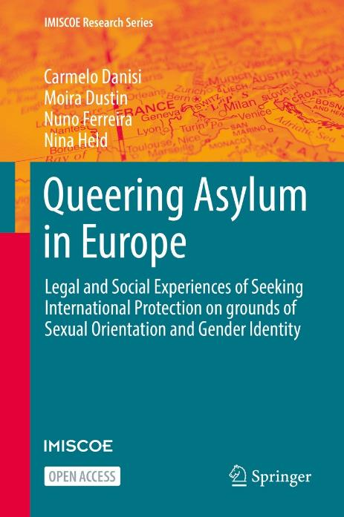
To find out more
Recommendations (tailored to EU, DE, IT and UK): https://www.sogica.org/en/final-recommendations/
Open access book ‘Queering Asylum in Europe’ – for full, academic analysis.
More about project, other publications and outputs: https://www.sogica.org/en/
Follow project on Twitter (@SOGICA1) and Facebook (@SOGICAProject)
Contact us on info@sogica.org

