Slide 1
S.O.G.I. Immigration and Reception in Italy. The Neapolitan experience
09° July 2020 SOGICA Final Conference
Dr. Carmela Ferrara
Coordinator of Migra-Antinoo

Slide 2
Migra-Antinoo was created as a service of Antinoo Arcigay Napoli specifically aimed at queer migrants.
The majority of people who use the service are homosexual or bisexual asylum seekers from West Africa. Few women and few trans people arrive.

Slide 3
Where do they come from?

Slide 4
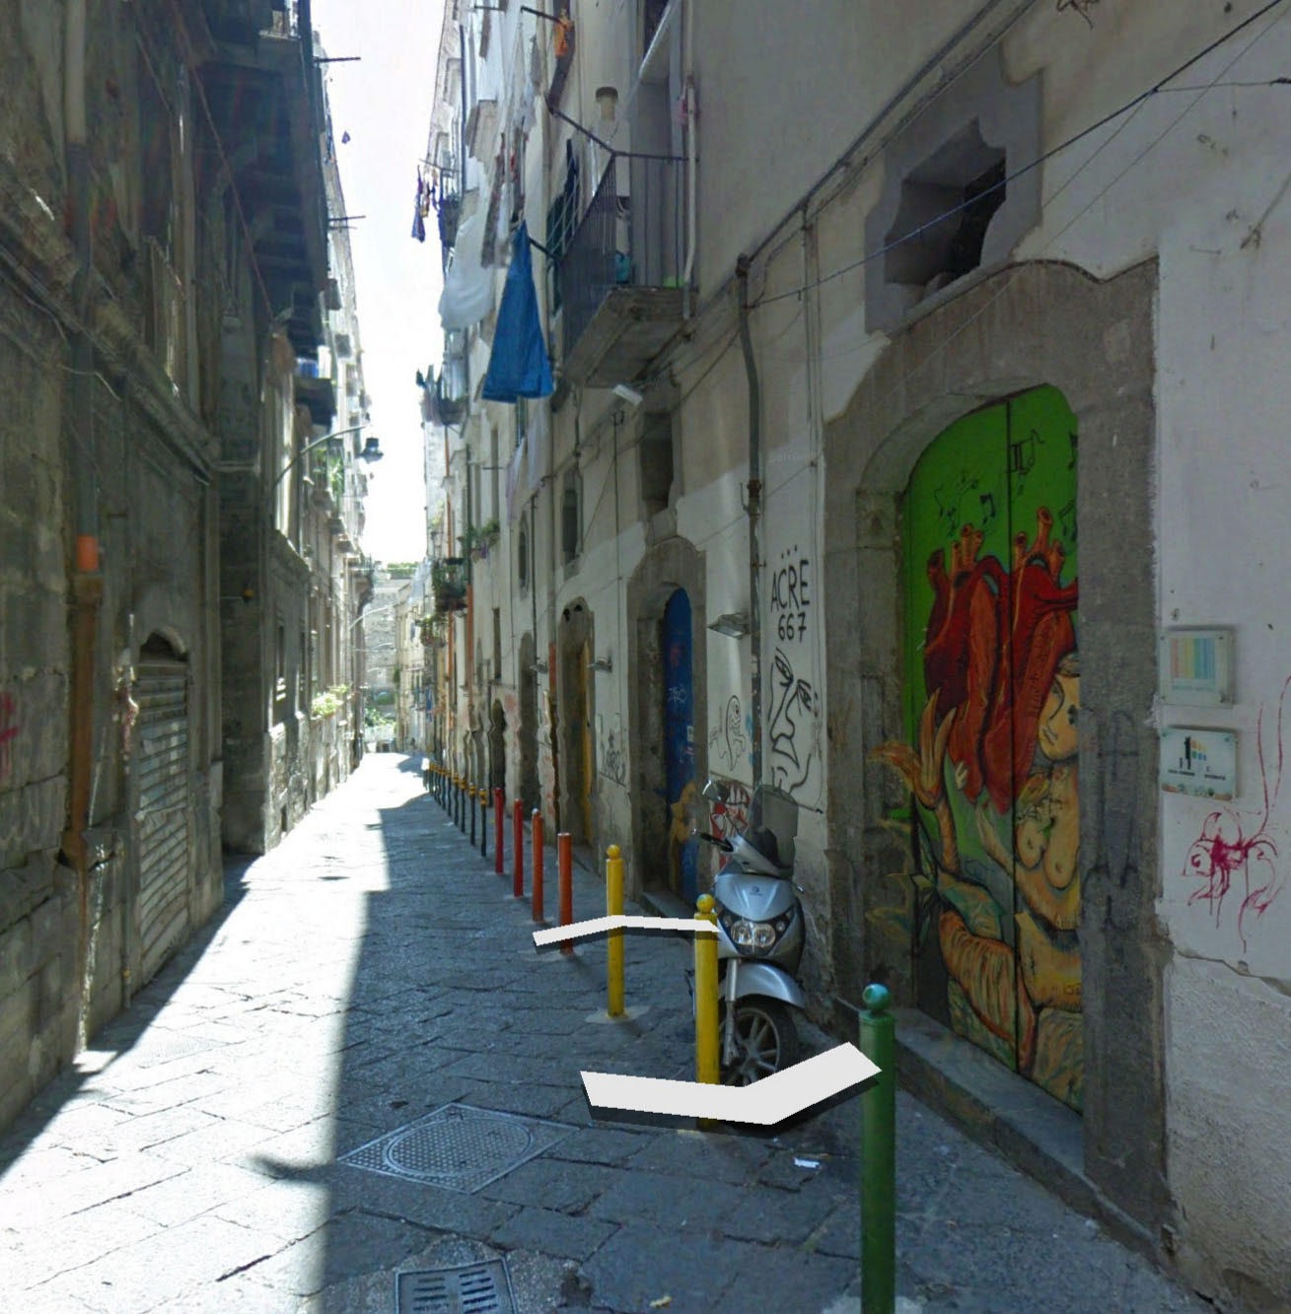
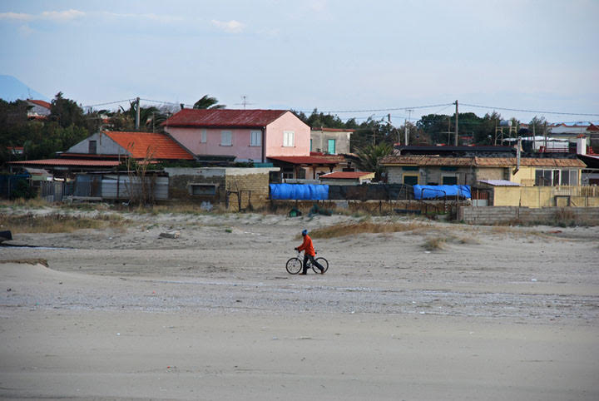
RURAL AREAS WHERE THEY LIVE
NAPLES, MIGRA-ANTINOO

Slide 5
No longer just a service
The participation of migrants has increased within the association, reaching up to almost 40% of the participants in the Youth Group.

Slide 7
Rethinking inclusive spaces
In order to make recreational and cultural activities accessible
to migrants, the youth group organizes watching movies
in English and in French
and meetings with psychologists
specialized in group therapy
who work with the technique of psychodrama and artistic therapy encouraging everyone to partecipate

Slide 8
A personal story
In the space of the psychological consultation, he had the opportunity to start reflecting on the situation of violence to which he was exposed for his sexual orientation and on the possible actions to regain his self-esteem. In this sense, the boy expresses his willingness to organize, at the youth group of Arcigay Naples - in which he declares to participate regularly for 1 year - a testimony meeting on what happened to him in Nigeria and on the life of homosexual people in the his country

Slide 9
The importance of sharing
Many migrants experienced their sexual identity with fear, violence and migratory travel and the will to talk about their story is a first indicator of the function of testimony.
As Hannah Arendt said, rebuilding a personal identity is a task that cannot be entrusted to the individual, but to the work of an entire community, because only by feeling part of a whole everyone can feel part of a humanity that lives in the plurality of identities.

Slide 10
In recent years, the number of services for migrants in LGBTI associations has increased
But most of the services are concentrated in the center-north. In fact, there are still very few spots
in the South

Slide 11
The paradigm shift
From a paternalistic attitude to a priorization of migrant voices/narratives
The challenge for Italian LGBTI associations is to encourage the participation of migrants
by recognizing space and representation

Slide 12
Suggestions / proposals
To create a national network of migrant activists, to organize a forum and exchange good practices.
Create common projects between north and south and with Europe.
Migra-Antinoo is available to start a communal dialogue. You can write us here: migranti@arcigaynapoli.org

Slide 13
Thanks for Your attention!
And thanks to
SOGICA
for increasing the dissemination and knowledge
of issues related to the topic

