Slide 1
‘Rainbow Statelessness’ Between Sexual Citizenship and Legal Theory: Exploring the Statelessness-SOGIESC Nexus for LGBTIQ+ Asylum Seekers
Thomas McGee, PhD Researcher, Peter McMullin Centre on Statelessness (Melbourne Law School) thomas.mcgee@student.unimelb.edu.au

Slide 2
This presentation draws on recently published research in the Statelessness & Citizenship Review

Slide 3
Statelessness – Legal Definition
1954 Convention Relating to the Status of Stateless Persons

Slide 4
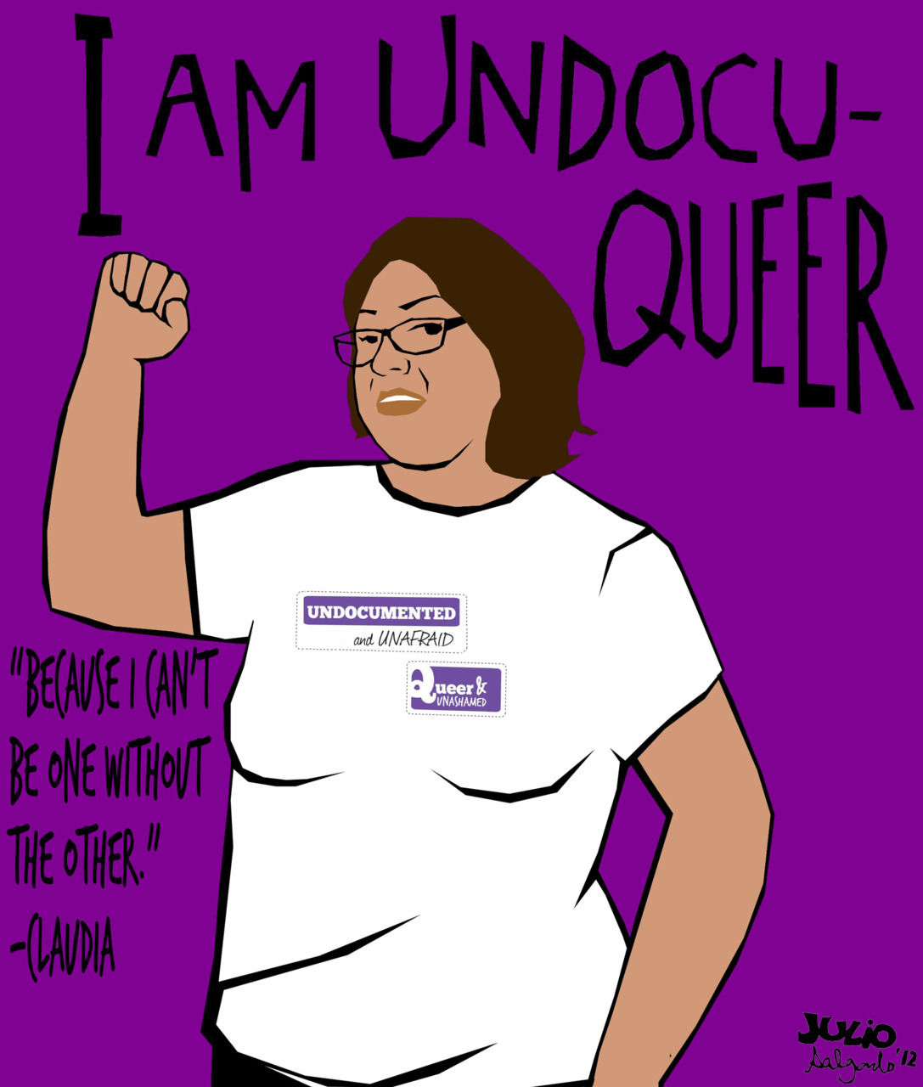
Where is Stateless-Queer?

Slide 5
Reasons for the Lack of Attention
Dispersed population
Lack of disclosure
“I think there is so little attention to this intersection because we are taboo everywhere. This is a chronic violation of human rights that is not even being discussed.”
Sexual Citizenship Vs. Statelessness Studies

Slide 6
Intersectional Relationship

Slide 7
Causal Relationship
At birth(for intersex)
Arbitrary Deprivation by the state (triggered by marriage/civil partnership)
Sex/Gender Transition (new status not recognised)
Self renunciation (to prevent deportation)
Children born to ‘rainbow families’

Slide 8
Conclusions/Further Research
Lack of relevant case law
Missed vulnerability in asylum procedures
Building coalitions between statelessness & SOGIESC work
Greater nuance/context-specific understandings

